Slide 1
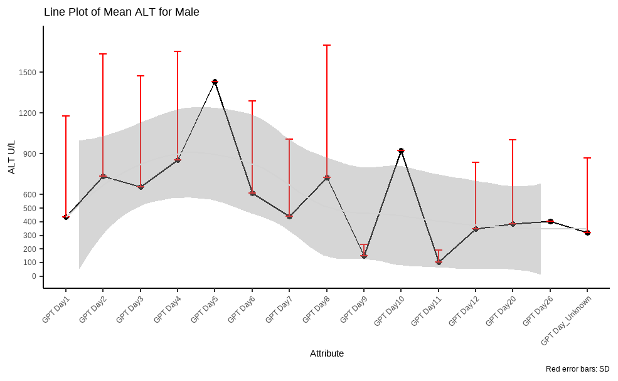
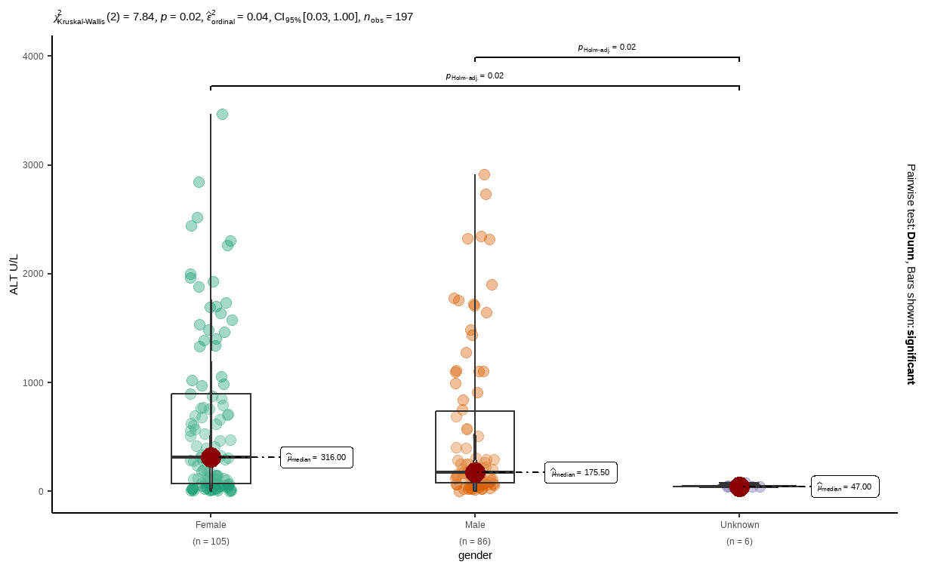
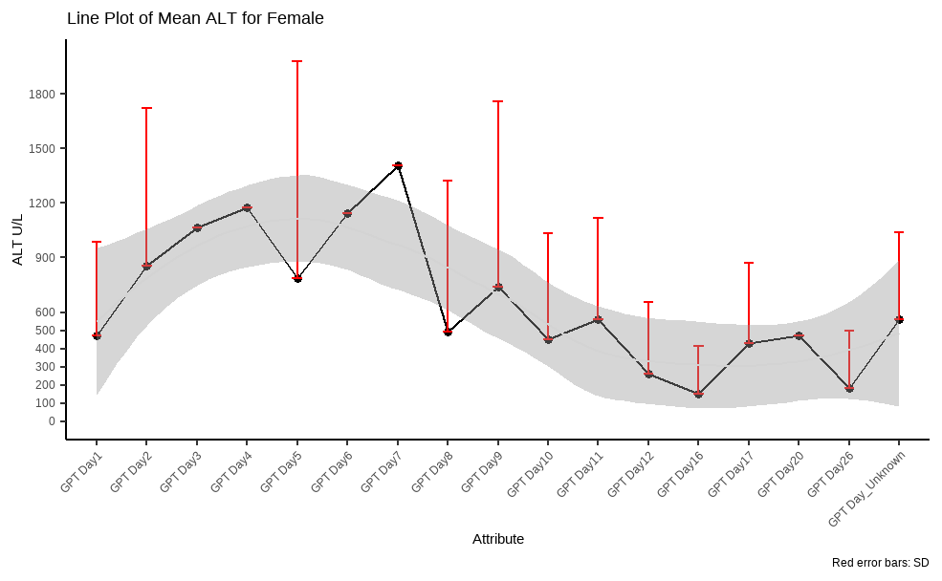
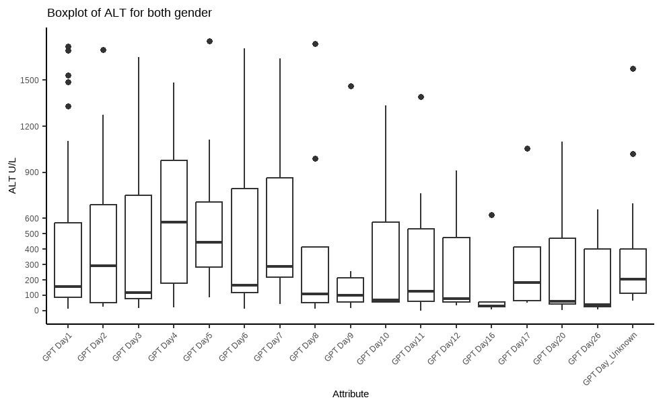
variable <chr> | gender <chr> | statistic <dbl> | p_value <dbl> | sample <dbl>
labreads | Female | 0.8058209 | 1.897277e-10 | 105
labreads | Male | 0.7171337 | 1.404412e-11 | 86
labreads | Unknown | 0.7506731 | 2.022462e-02 | 6
Add number of measurements as „N=„ to each point
Add dots for single datapoints
Adjust headlines if necessary

Slide 2
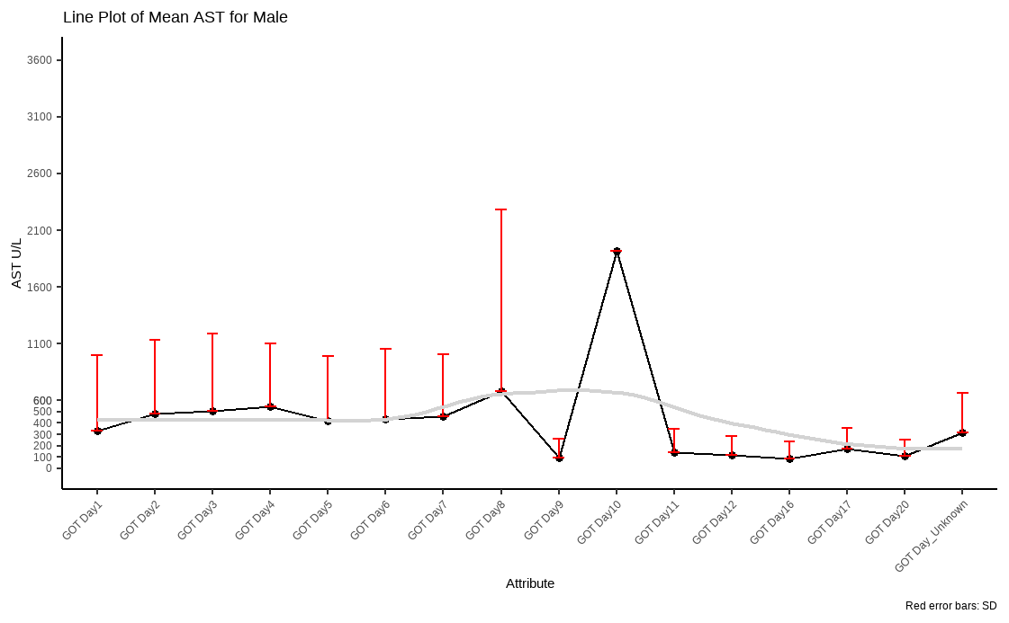
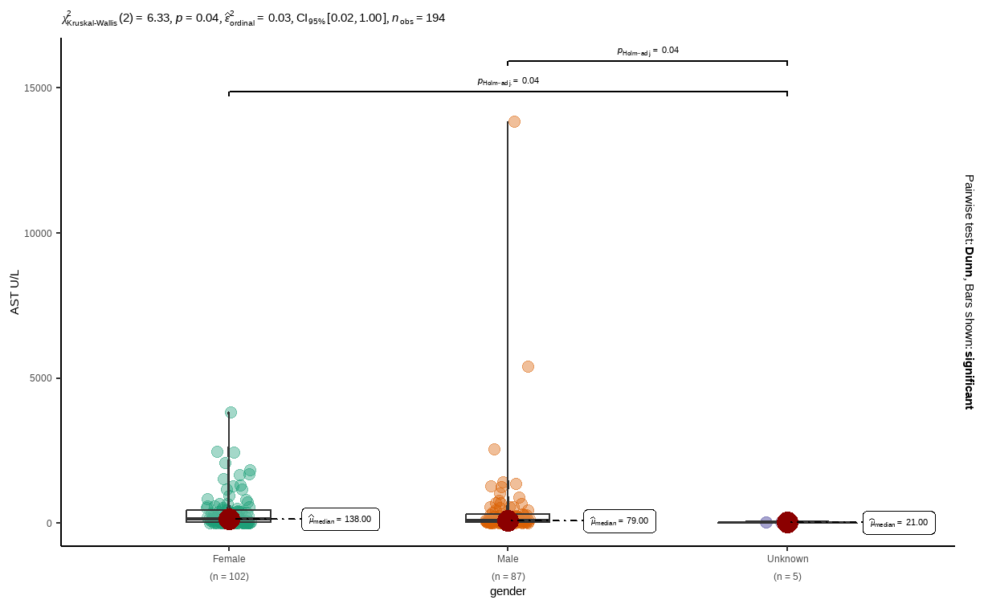
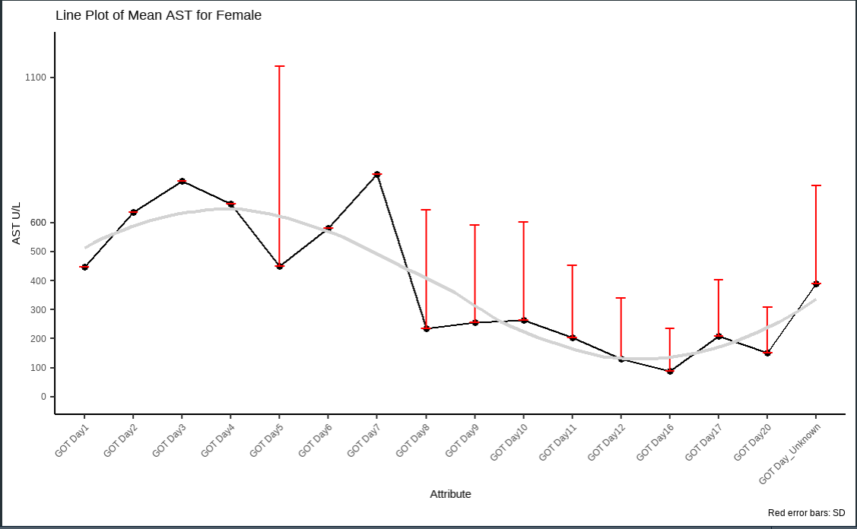
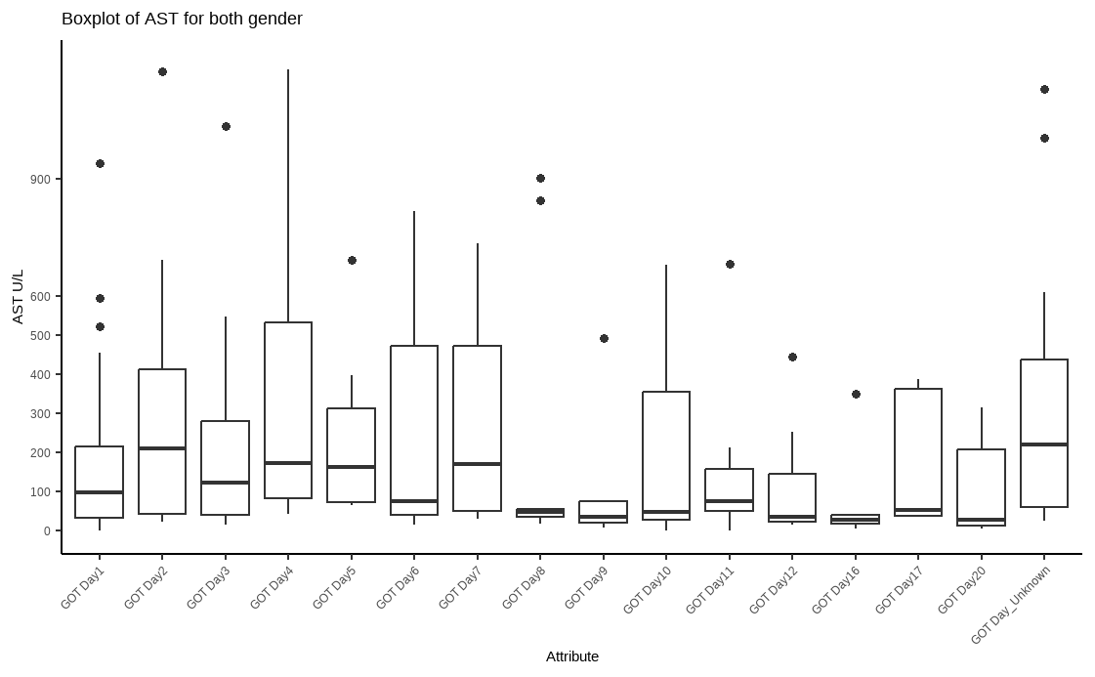
variable <chr> | gender <chr> | statistic <dbl> | p_value <dbl> | sample <dbl>
labreads | Female | 0.6552554 | 9.205710e-14 | 97
labreads | Male | 0.2516759 | 5.561552e-19 | 87
labreads | Unknown | 0.8668231 | 2.537967e-01 | 5
Change scale for better visibility -> not possible because its auto-generated

Slide 3
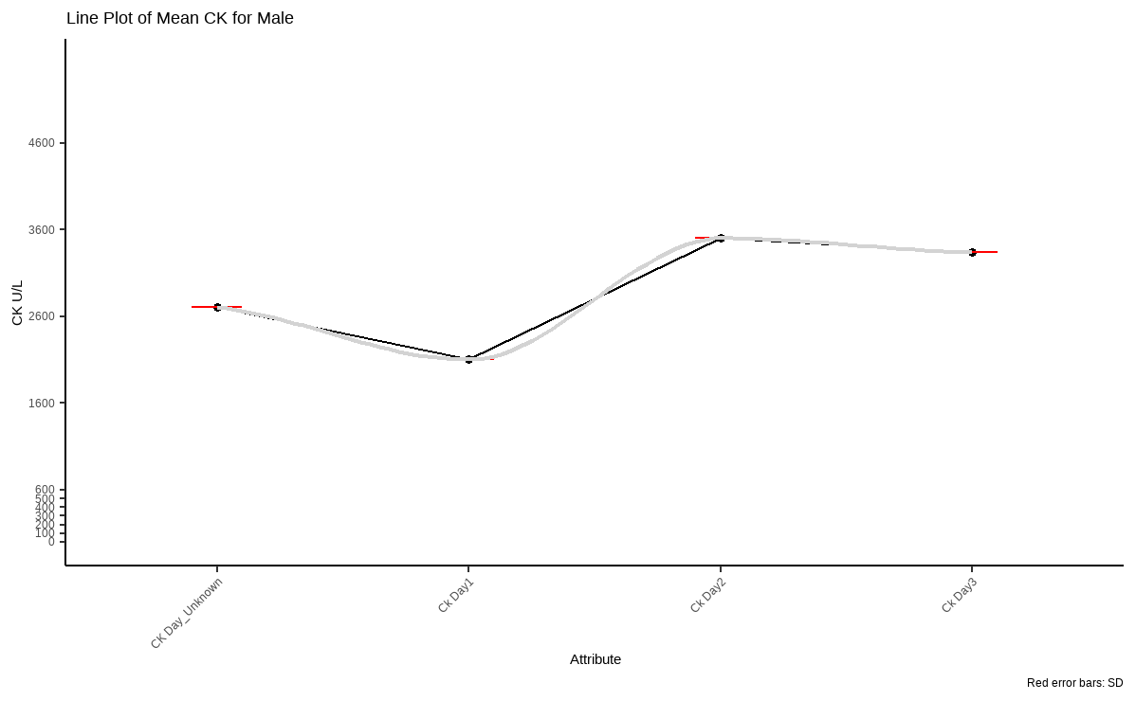
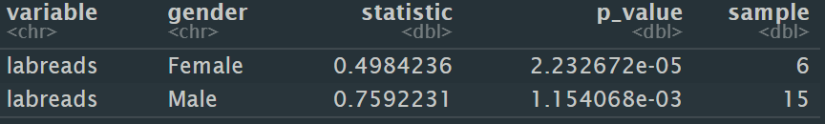
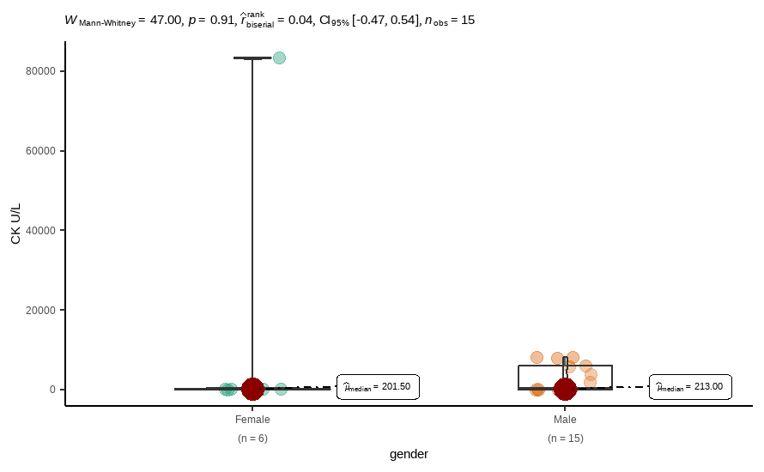
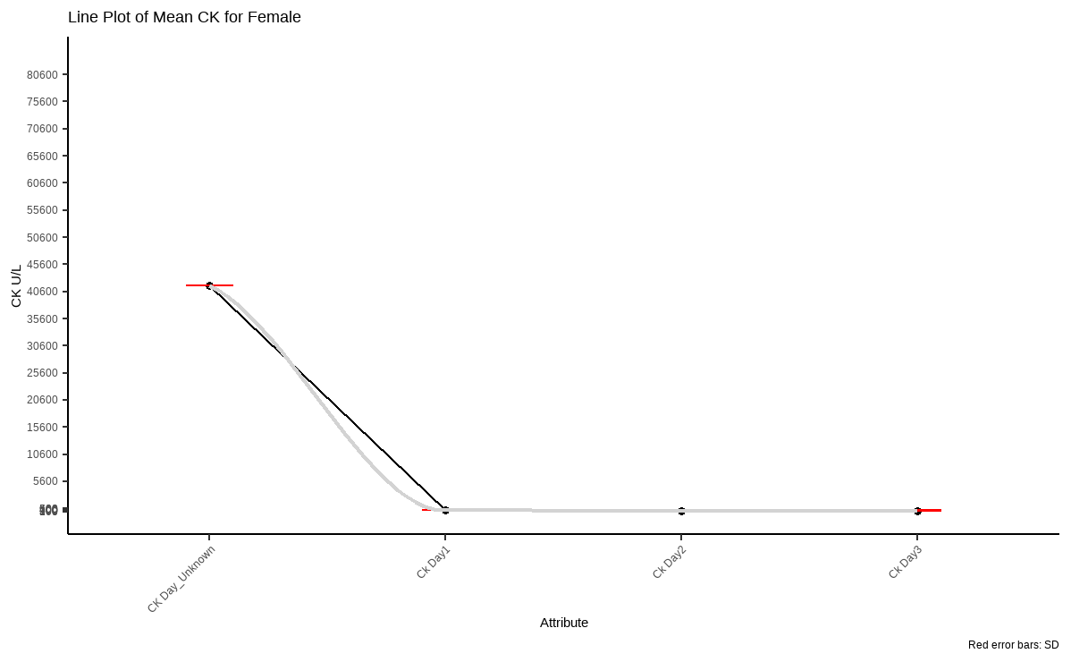
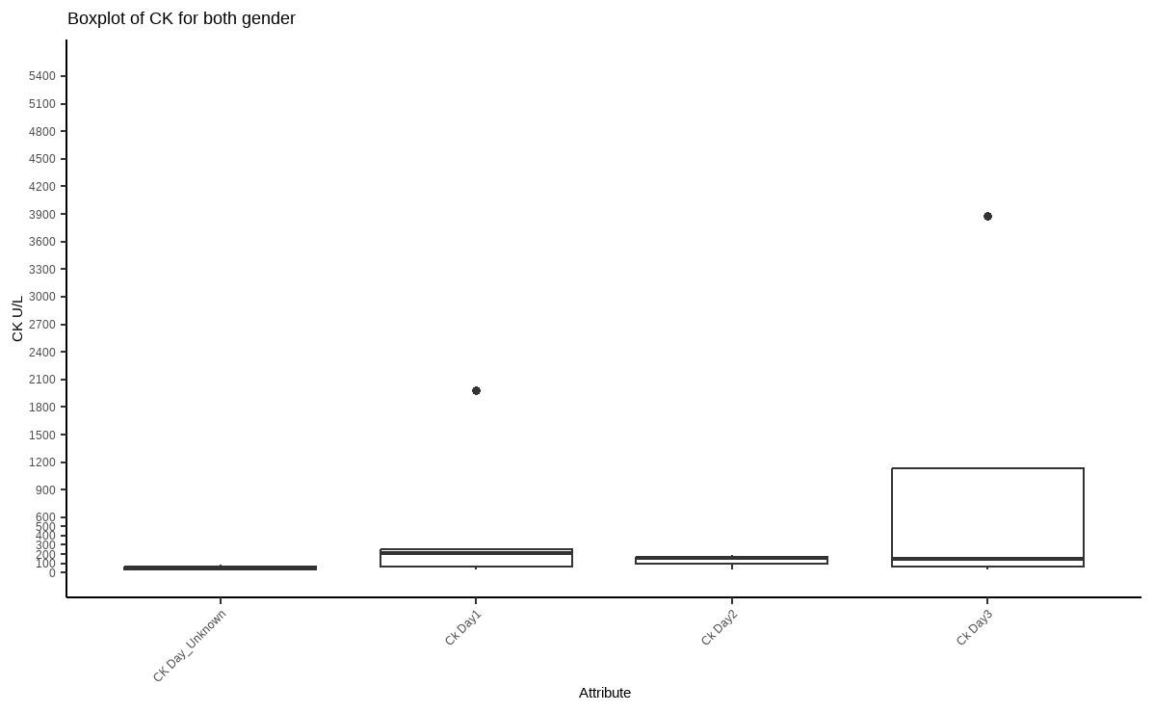

Slide 4
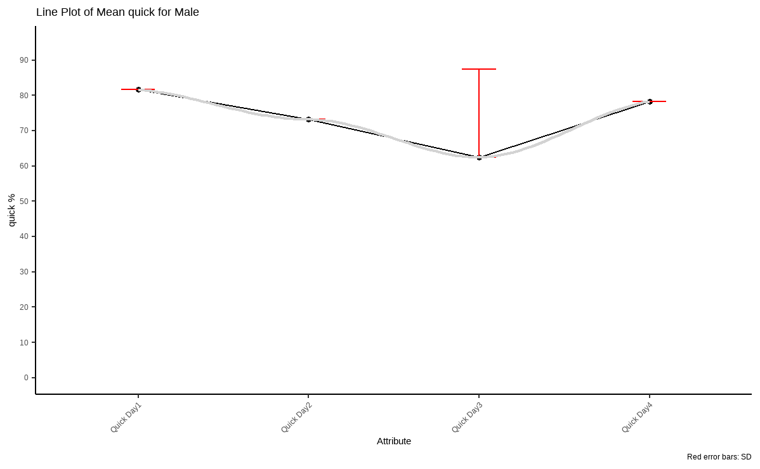
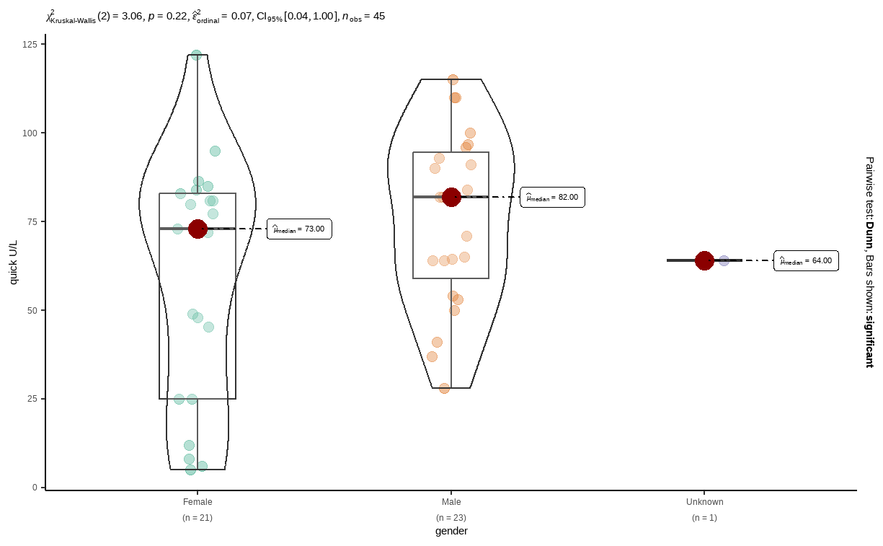
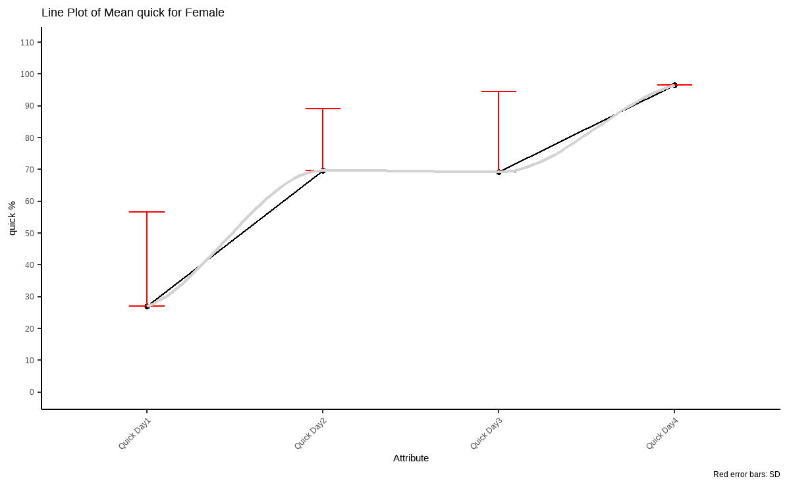
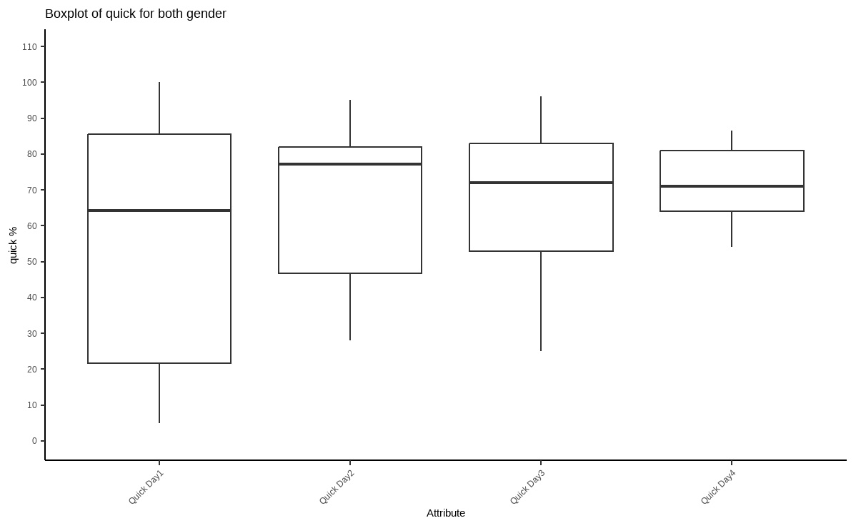
variable <chr> | gender <chr> | statistic <dbl> | p_value <dbl> | sample <dbl>
labreads | Female | 0.4984236 | 2.232672e-05 | 6
labreads | Male | 0.7592231 | 1.154068e-03 | 15

Slide 5
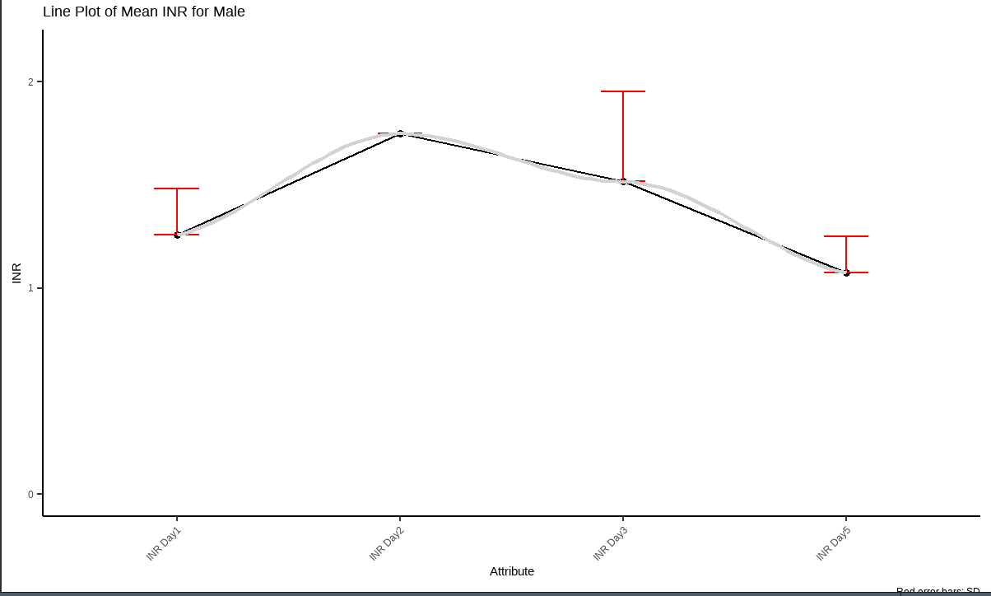
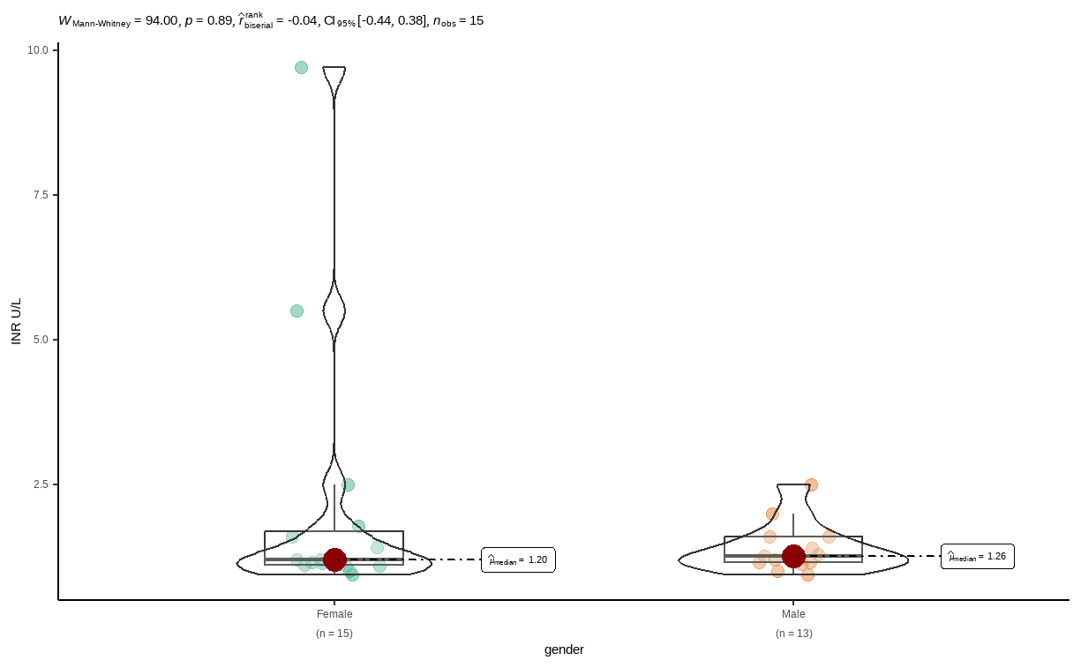
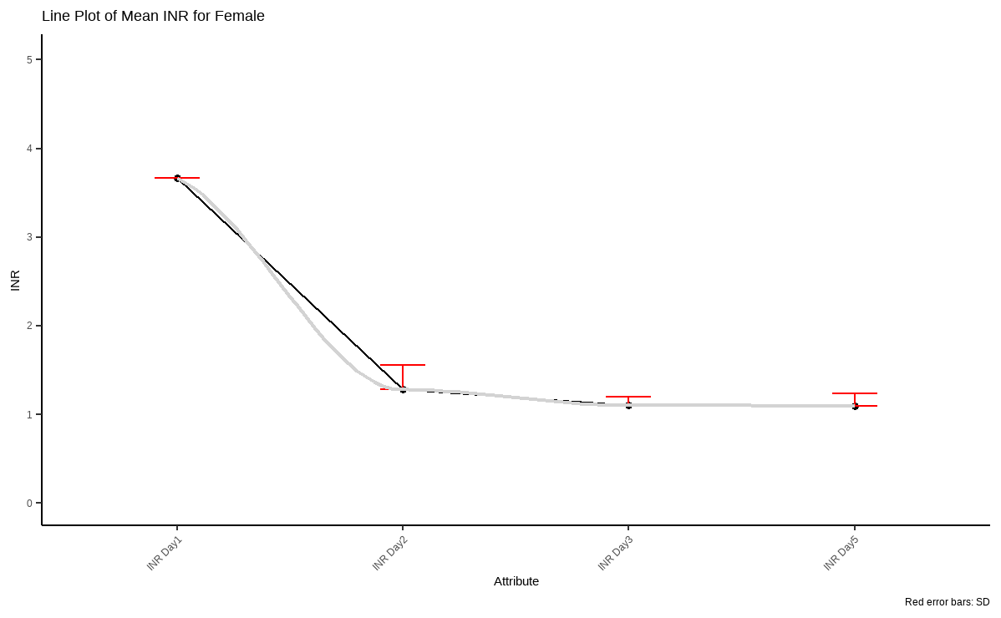
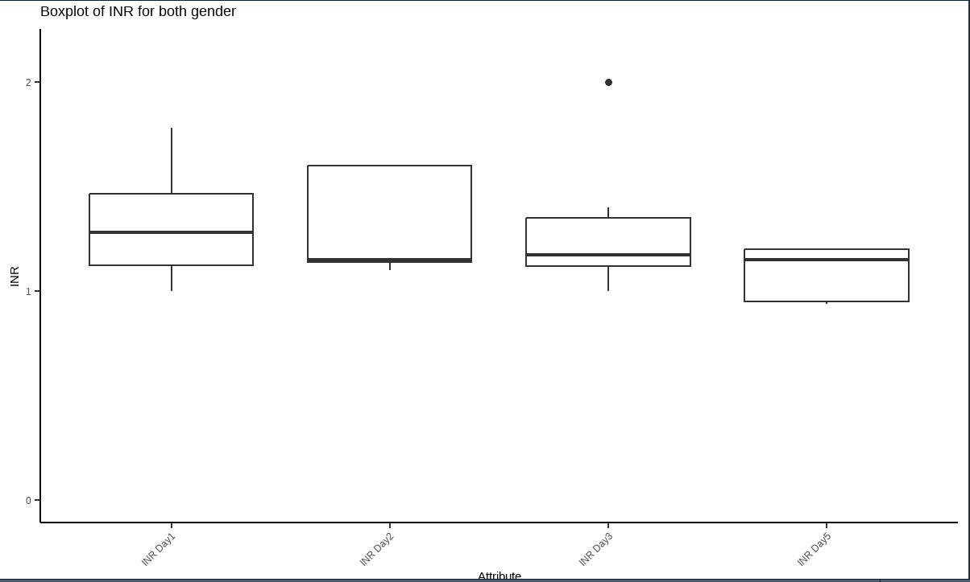
variable <chr> | gender <chr> | statistic <dbl> | p_value <dbl> | sample <dbl>
labreads | Female | 0.5448737 | 8.286363e-06 | 15
labreads | Male | 0.8428090 | 2.302316e-02 | 13

Slide 6
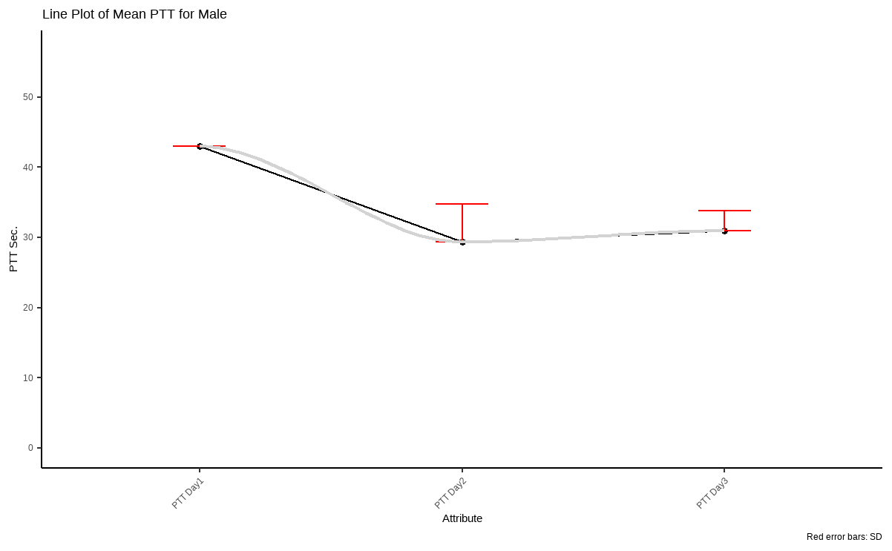
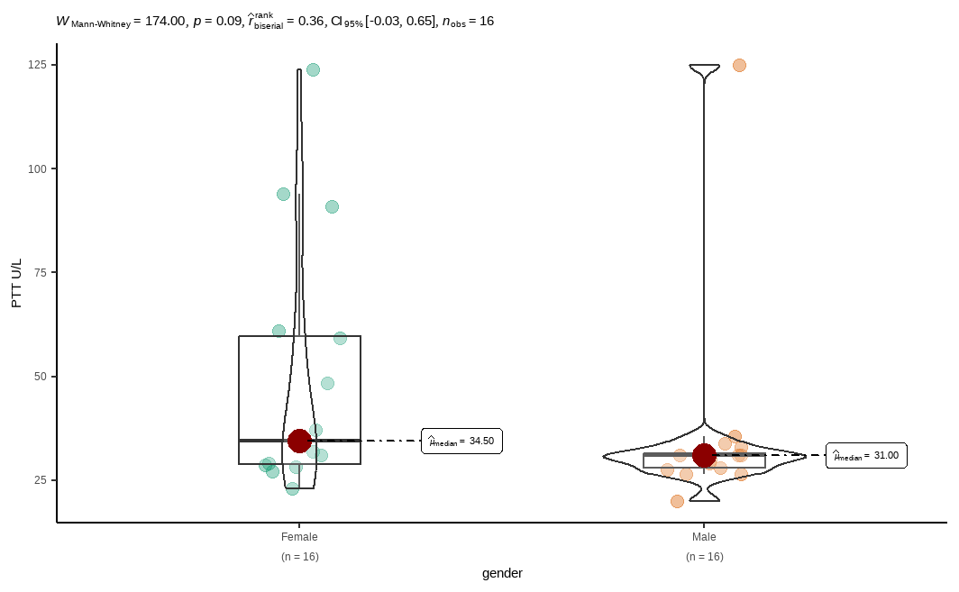
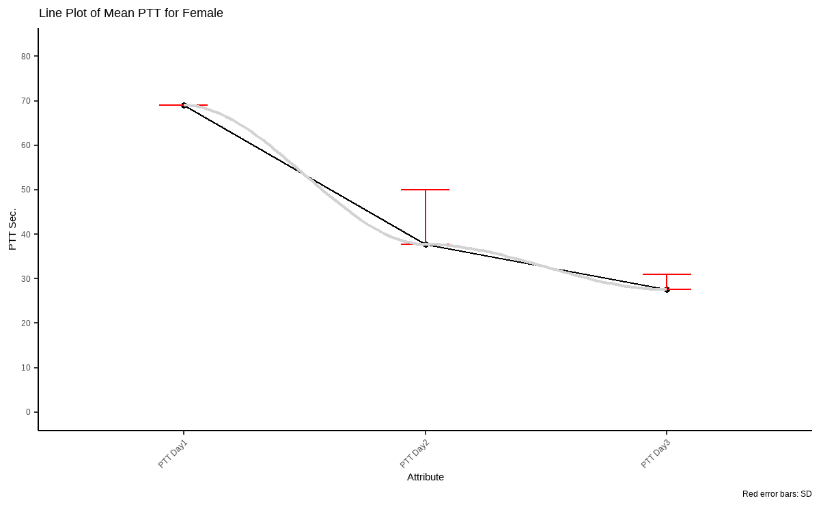
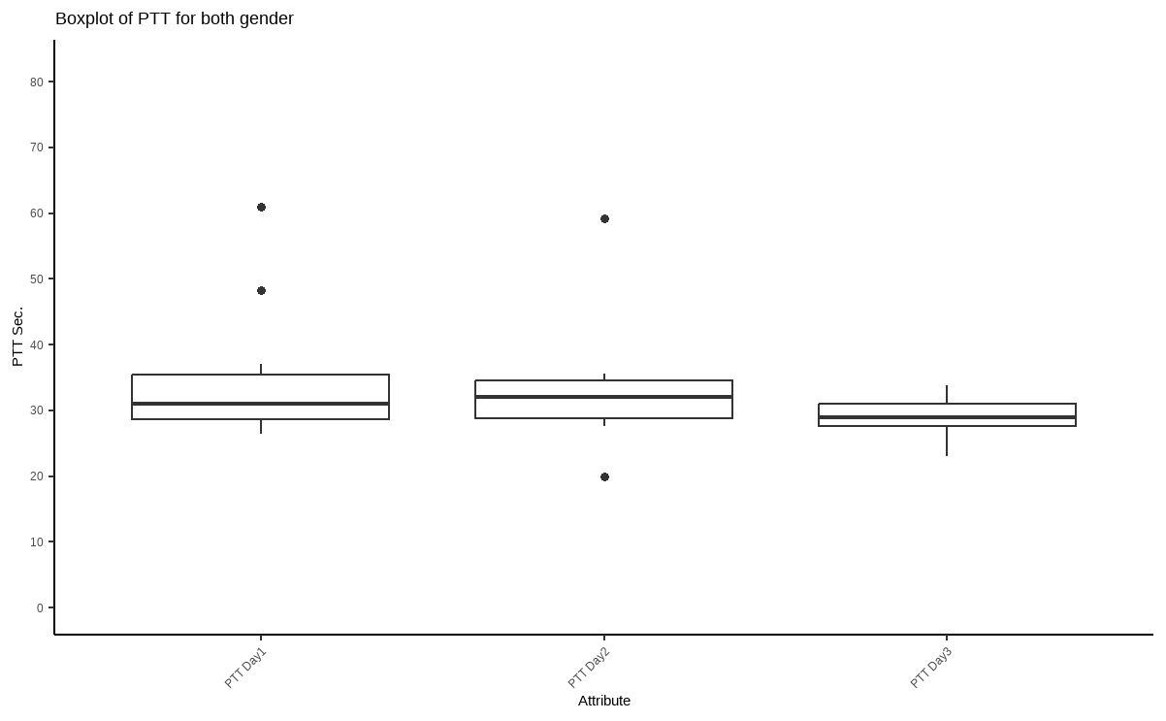
variable <chr> | gender <chr> | statistic <dbl> | p_value <dbl> | sample <dbl>
labreads | Female | 0.7792670 | 1.463744e-03 | 16
labreads | Male | 0.4091198 | 4.090481e-07 | 16

Slide 7
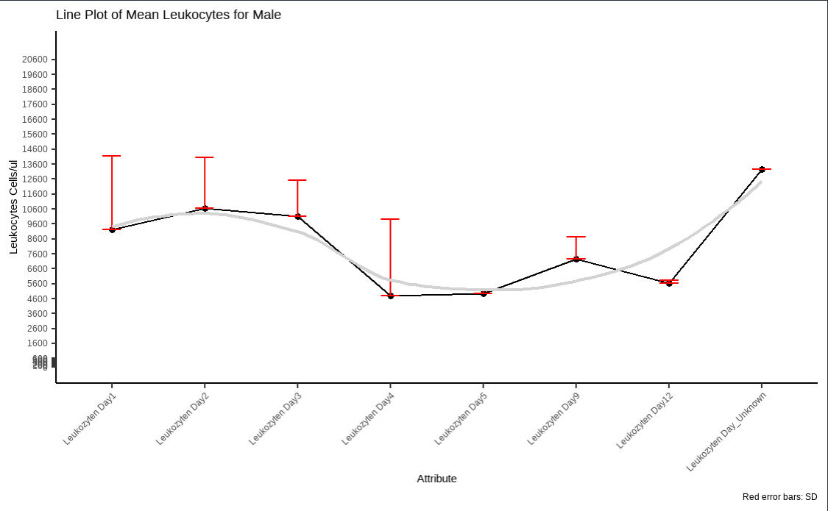
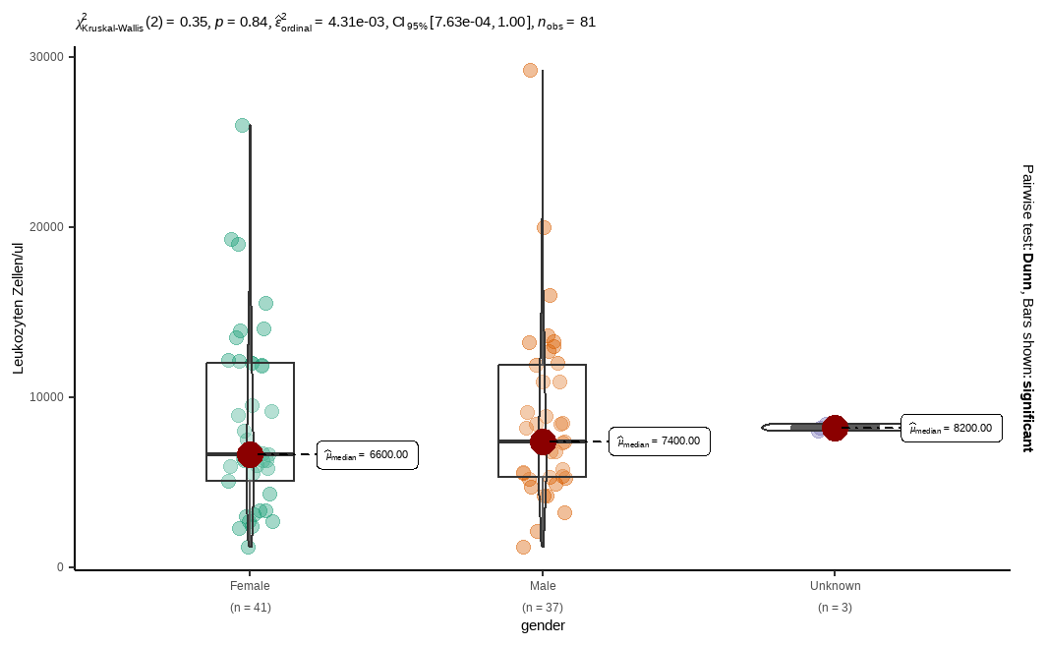
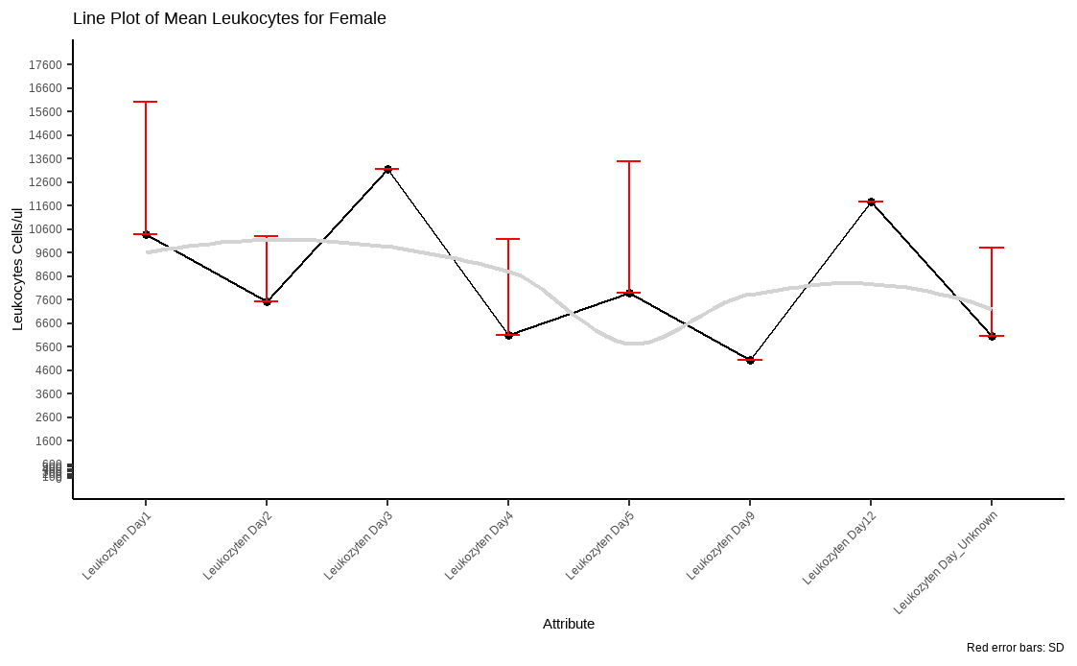
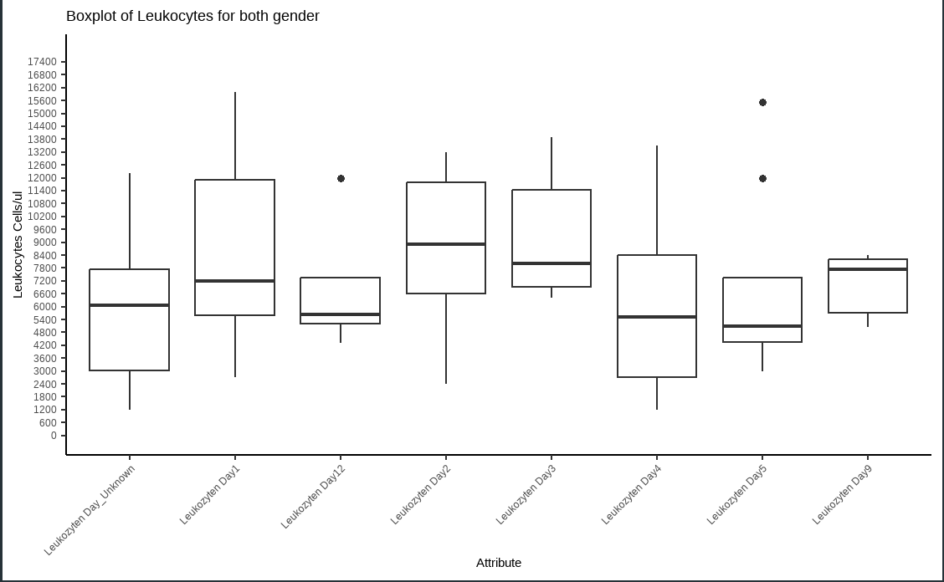
variable <chr> | gender <chr> | statistic <dbl> | p_value <dbl> | sample <dbl>
labreads | Female | 0.9020908 | 0.0019123831 | 41
labreads | Male | 0.8623446 | 0.0003097419 | 37
labreads | Unknown | 1.0000000 | 1.0000000000 | 3

Slide 8
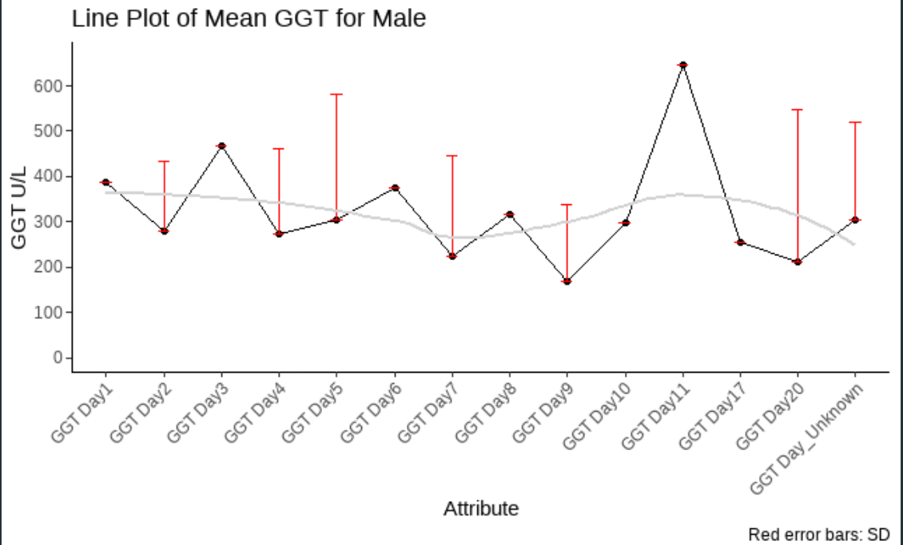
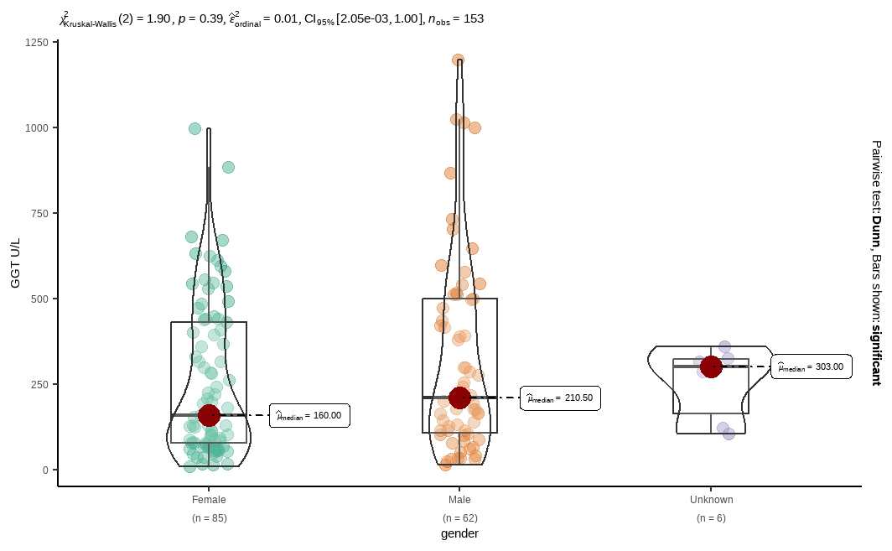
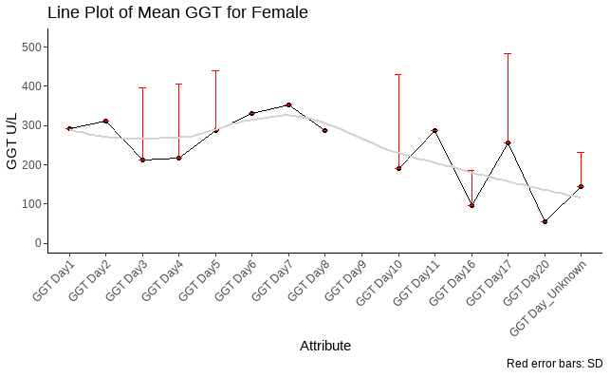
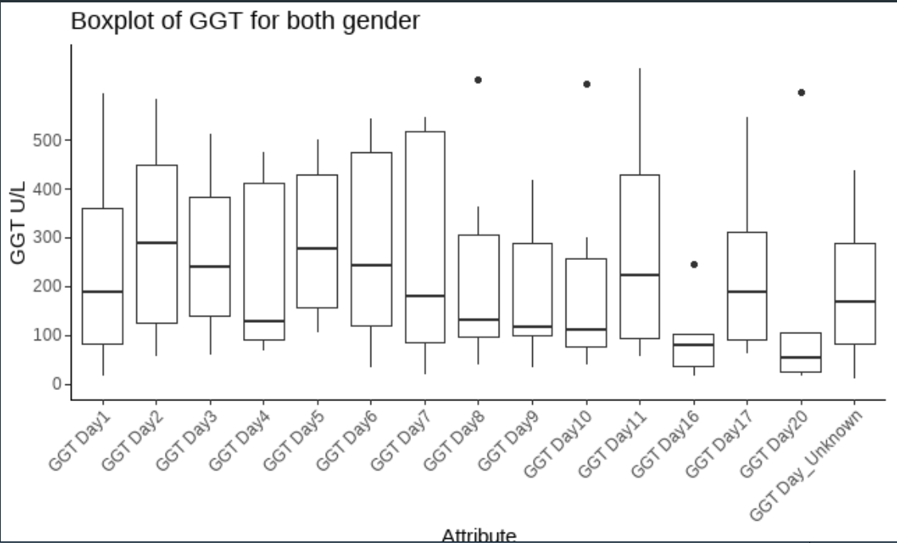
variable <chr> | gender <chr> | statistic <dbl> | p_value <dbl> | sample <dbl>
labreads | Female | 0.8725314 | 5.351648e-07 | 85
labreads | Male | 0.8671436 | 7.577154e-06 | 62
labreads | Unknown | 0.8224498 | 9.265626e-02 | 6

Slide 9
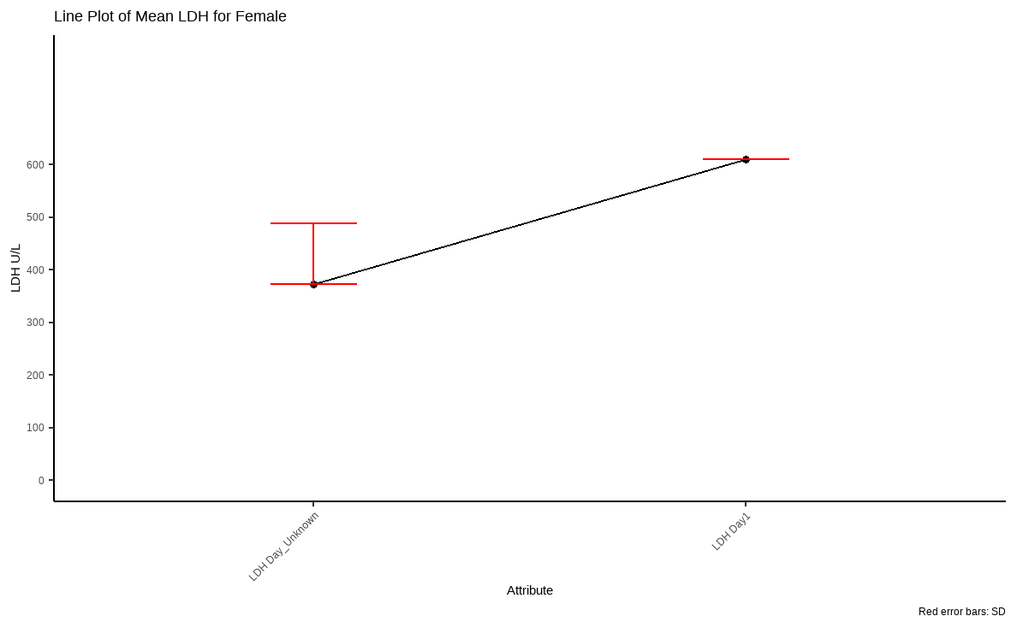
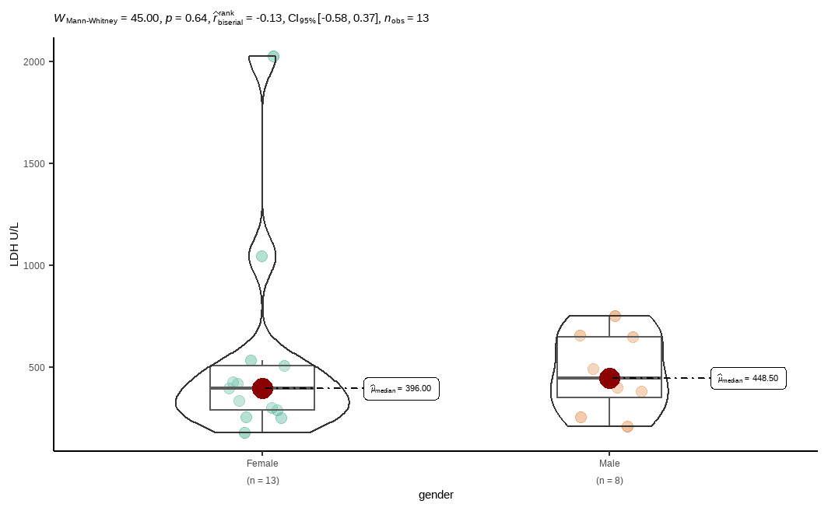
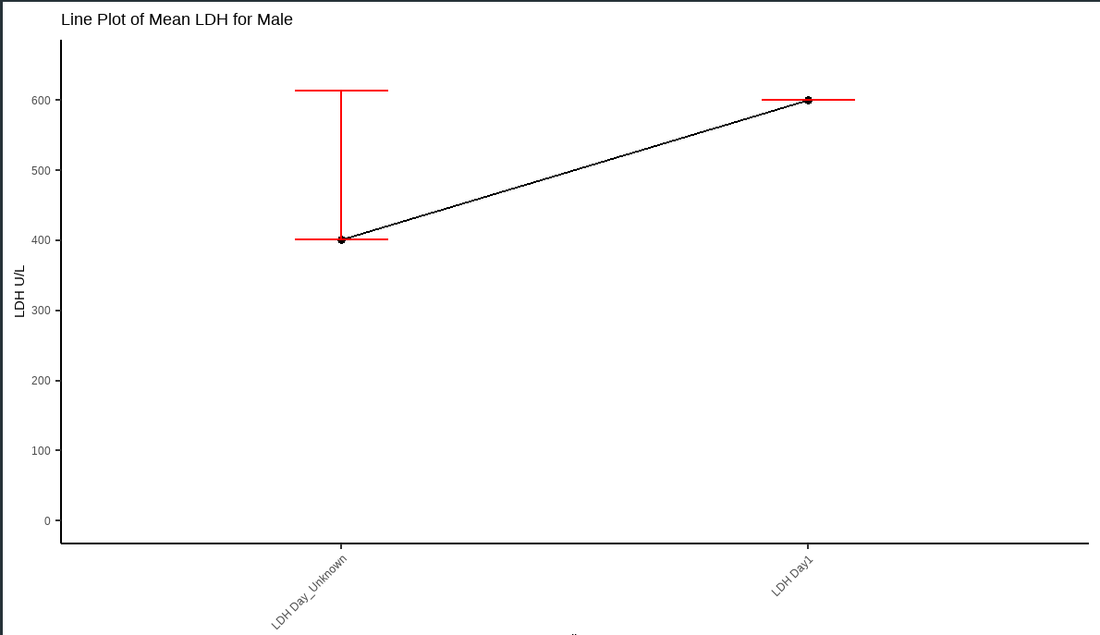
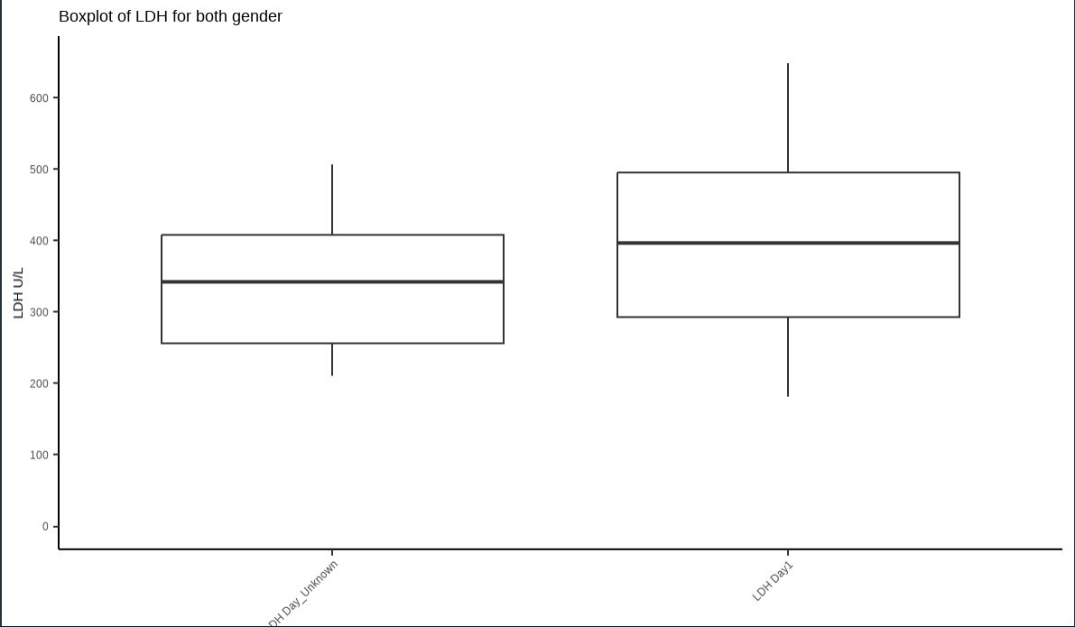
variable <chr> | gender <chr> | statistic <dbl> | p_value <dbl> | sample <dbl>
labreads | Female | 0.6377594 | 0.0001414814 | 13
labreads | Male | 0.9428881 | 0.6397015610 | 8

Slide 10
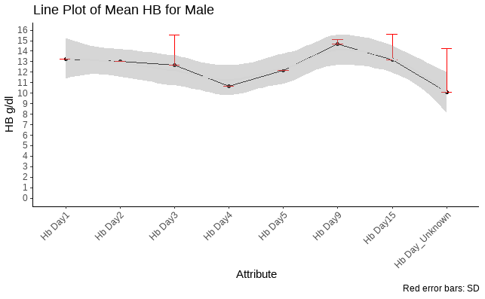
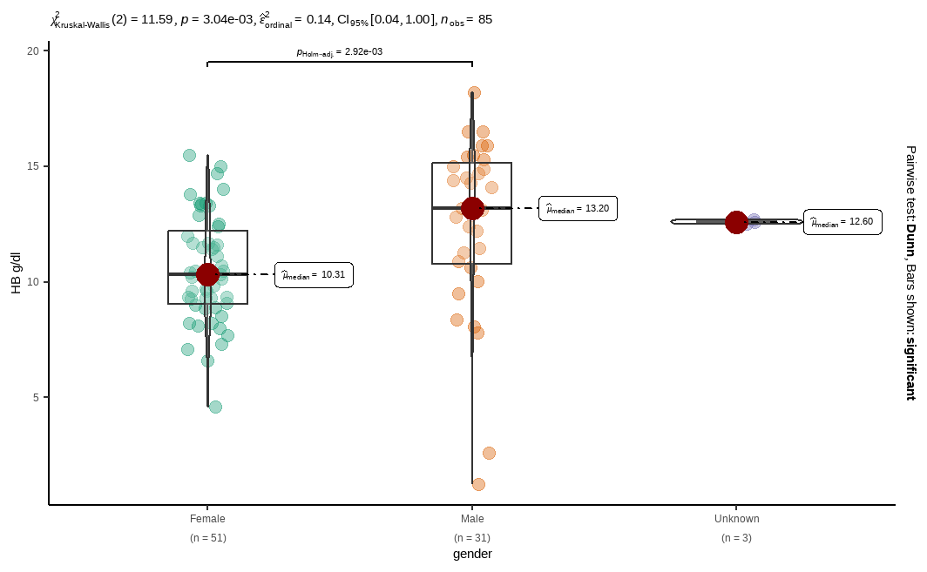
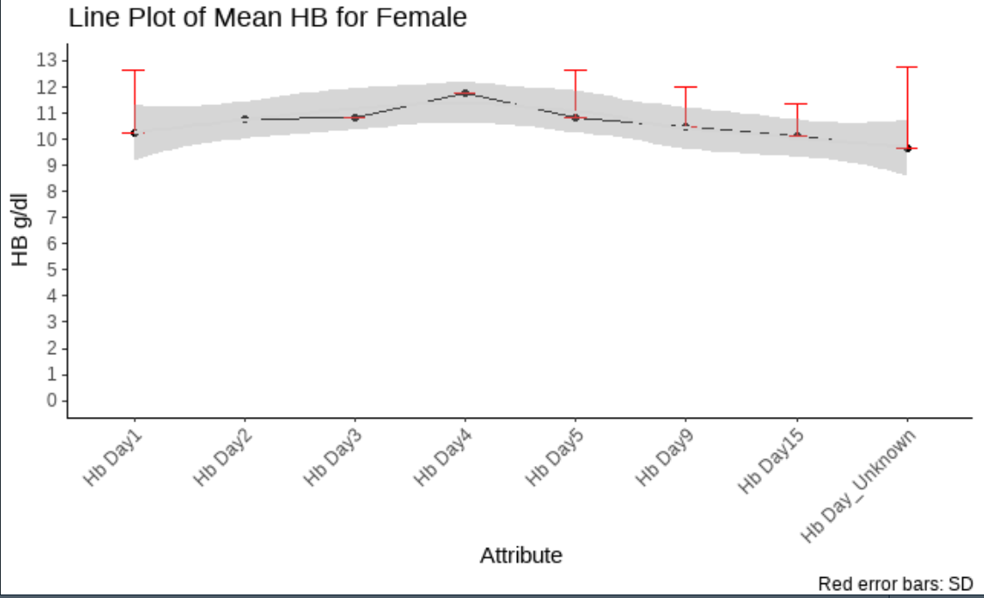
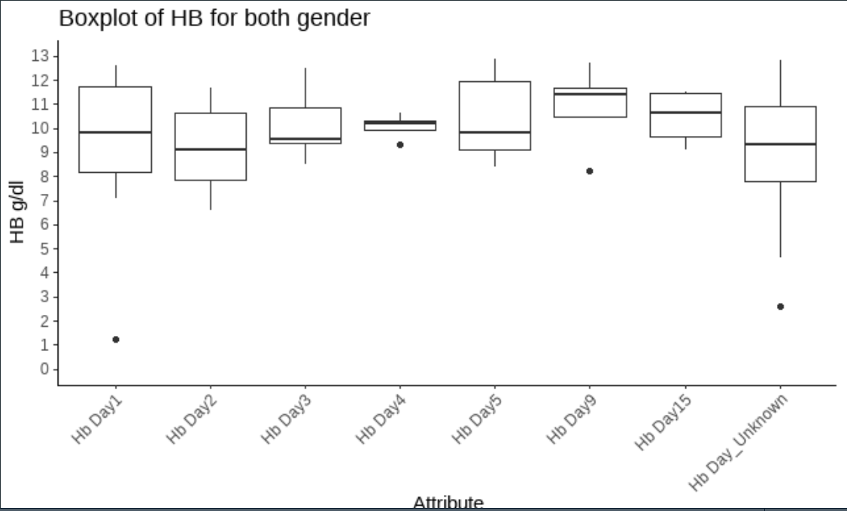
variable <chr> | gender <chr> | statistic <dbl> | p_value <dbl> | sample <dbl>
labreads | Female | 0.9849471 | 0.75933877 | 51
labreads | Male | 0.8935505 | 0.00499436 | 31
labreads | Unknown | 1.0000000 | 1.00000000 | 3

Slide 11
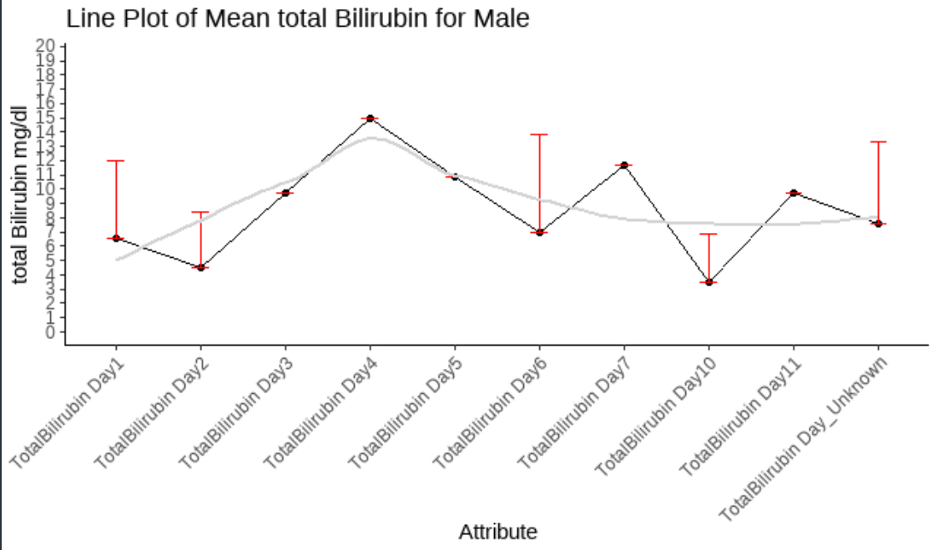
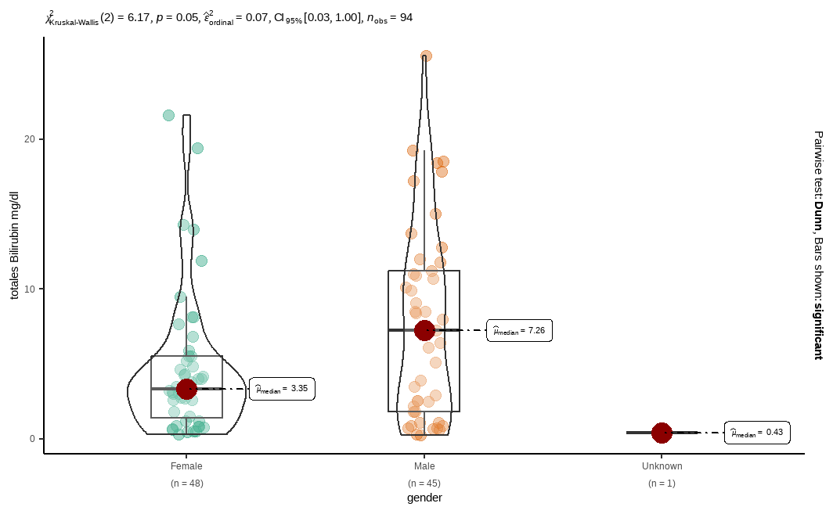
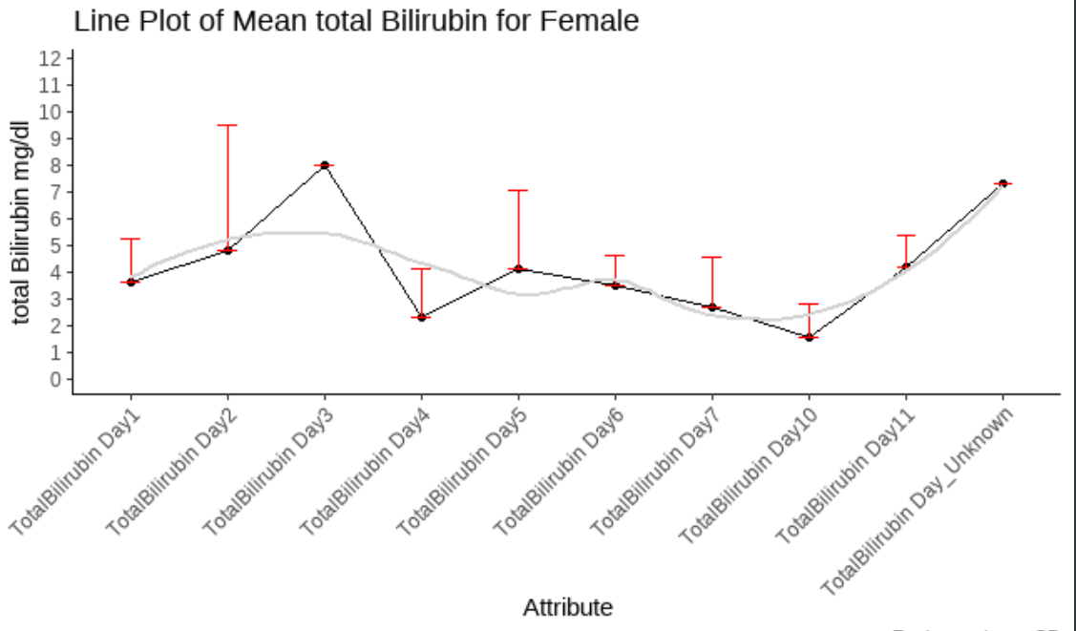
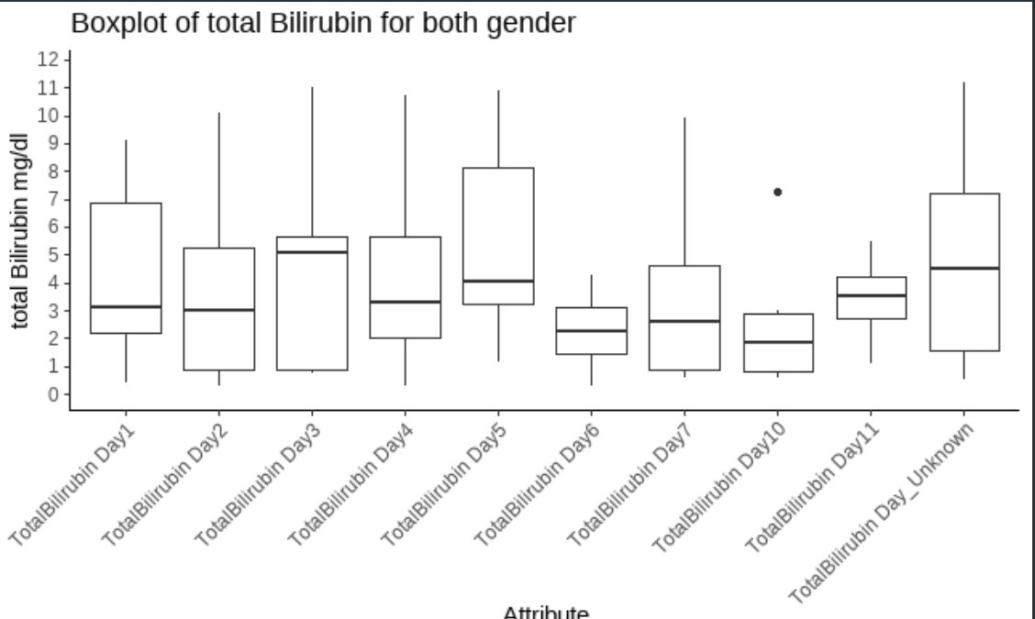
variable <chr> | gender <chr> | statistic <dbl> | p_value <dbl> | sample <dbl>
labreads | Female | 0.7781218 | 4.304505e-07 | 48
labreads | Male | 0.9104027 | 2.030207e-03 | 45
labreads | Unknown | NA | NA | 1

Slide 12
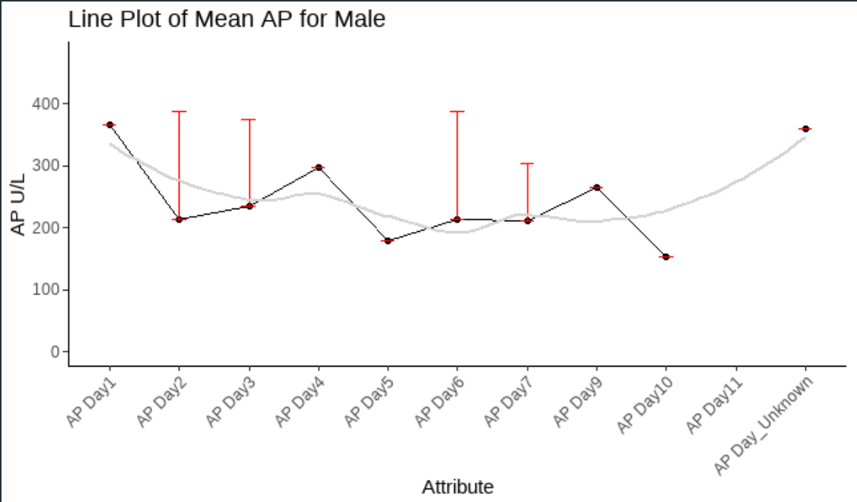
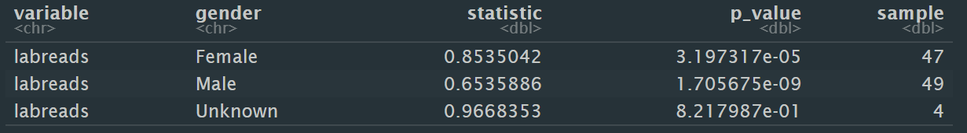
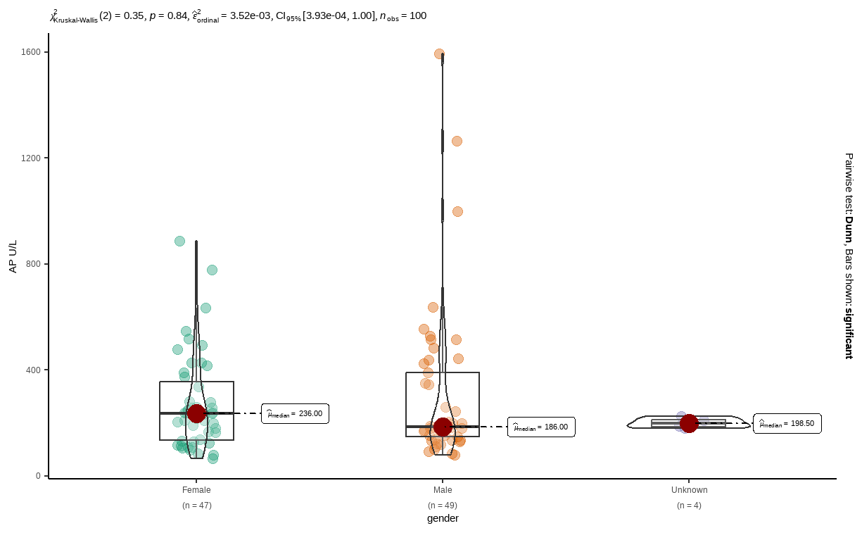
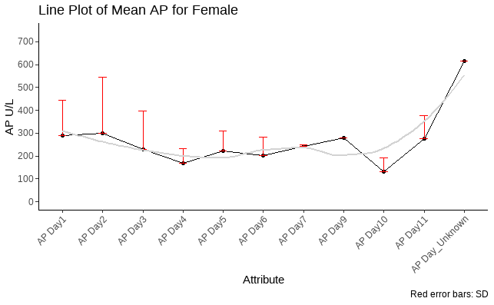
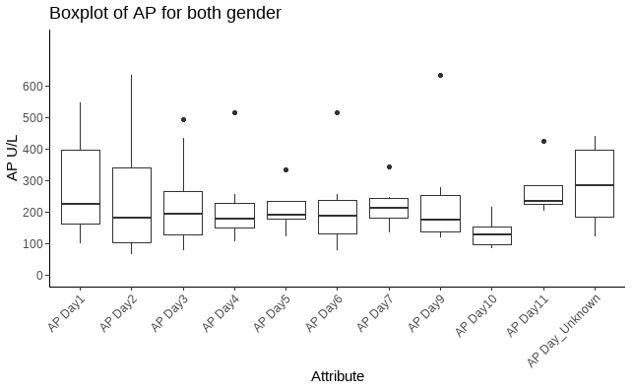

Slide 13




variable <chr> | gender <chr> | statistic <dbl> | p_value <dbl> | sample <dbl>
labreads | Female | 0.7923768 | 2.317181e-05 | 33
labreads | Male | 0.6034078 | 1.160480e-08 | 36

Slide 14






Slide 15




variable <chr> | gender <chr> | statistic <dbl> | p_value <dbl> | sample <dbl>
labreads | Female | 0.9221264 | 4.101349e-01 | 9
labreads | Male | 0.5788528 | 4.206117e-06 | 18

Slide 16

variable <chr> | gender <chr> | statistic <dbl> | p_value <dbl> | sample <dbl>
labreads | Female | 0.8950202 | 0.0054262388 | 31
labreads | Male | 0.7499858 | 0.0001238857 | 21
labreads | Unknown | 1.0000000 | 1.0000000000 | 3
Skalierung nicht sichtbar

Slide 17




variable <chr> | gender <chr> | statistic <dbl> | p_value <dbl> | sample <dbl>
labreads | Female | 0.9435821 | 0.094645408 | 32
labreads | Male | 0.8595466 | 0.001202776 | 29
labreads | Unknown | 0.9998684 | 0.978093852 | 3

Slide 18




variable <chr> | gender <chr> | statistic <dbl> | p_value <dbl> | sample <dbl>
labreads | Female | 0.9479109 | 0.09774589 | 35
labreads | Male | 0.9460710 | 0.20416230 | 25
labreads | Unknown | 0.7500000 | 0.00000000 | 3

Slide 19




variable <chr> | gender <chr> | statistic <dbl> | p_value <dbl> | sample <dbl>
labreads | Female | 0.9259265 | 0.33892642 | 12
labreads | Male | 0.8824683 | 0.04240402 | 16

Slide 20




variable <chr> | gender <chr> | statistic <dbl> | p_value <dbl> | sample <dbl>
labreads | Female | 0.9077867 | 0.06742676 | 19
labreads | Male | 0.9632789 | 0.61122088 | 20

Slide 21




variable <chr> | gender <chr> | statistic <dbl> | p_value <dbl> | sample <dbl>
labreads | Female | 0.8821439 | 0.2361361 | 7
labreads | Male | 0.8982241 | 0.2418852 | 9

Slide 22






